Slide 1
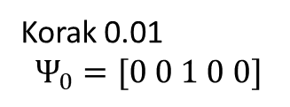
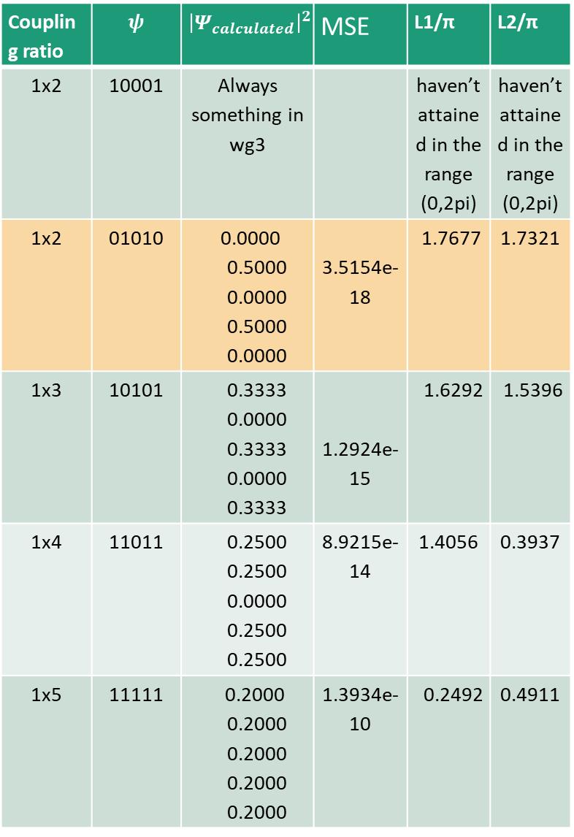
Coupling ratio | $$ψ$$ | $${\left|Ψ_{calculated}\right|}^{2}$$ | MSE | L1/π | L2/π
1x2 | 10001 | Always something in wg3 |  | haven’t attained in the range (0,2pi) | haven’t attained in the range (0,2pi)
1x2 | 01010 | 0.0000 0.5000 0.0000 0.5000 0.0000 | 3.5154e-18 | 1.7677 | 1.7321
1x3 | 10101 | 0.3333 0.0000 0.3333 0.0000 0.3333 | 1.2924e-15 | 1.6292 | 1.5396
1x4 | 11011 | 0.2500 0.2500 0.0000 0.2500 0.2500 | 8.9215e-14 | 1.4056 | 0.3937
1x5 | 11111 | 0.2000 0.2000 0.2000 0.2000 0.2000 | 1.3934e-10 | 0.2492 | 0.4911
Korak 0.01
$$Ψ_{0}=[0 0 1 0 0]$$
L2
L1

Slide 2
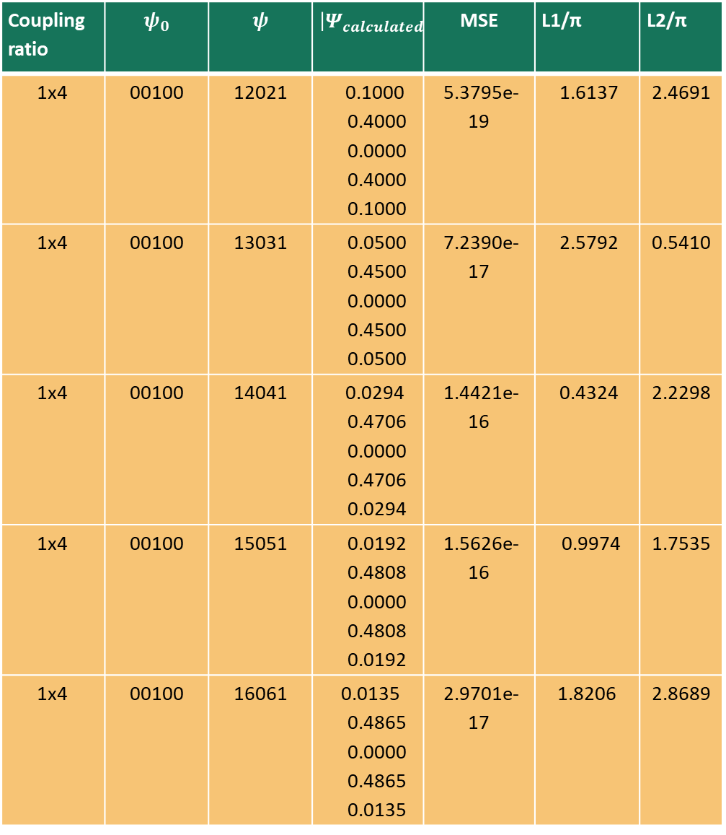
Coupling ratio | $$ψ_{0}$$ | $$ψ$$ | $${\left|Ψ_{calculated}\right|}^{2}$$ | MSE | L1/π | L2/π
1x4 | 00100 | 12021 | 0.1000 0.4000 0.0000 0.4000 0.1000 | 5.3795e-19 | 1.6137 | 2.4691
1x4 | 00100 | 13031 | 0.0500 0.4500 0.0000 0.4500 0.0500 | 7.2390e-17 | 2.5792 | 0.5410
1x4 | 00100 | 14041 | 0.0294 0.4706 0.0000 0.4706 0.0294 | 1.4421e-16 | 0.4324 | 2.2298
1x4 | 00100 | 15051 | 0.0192 0.4808 0.0000 0.4808 0.0192 | 1.5626e-16 | 0.9974 | 1.7535
1x4 | 00100 | 16061 | 0.0135 0.4865 0.0000 0.4865 0.0135 | 2.9701e-17 | 1.8206 | 2.8689

Slide 3
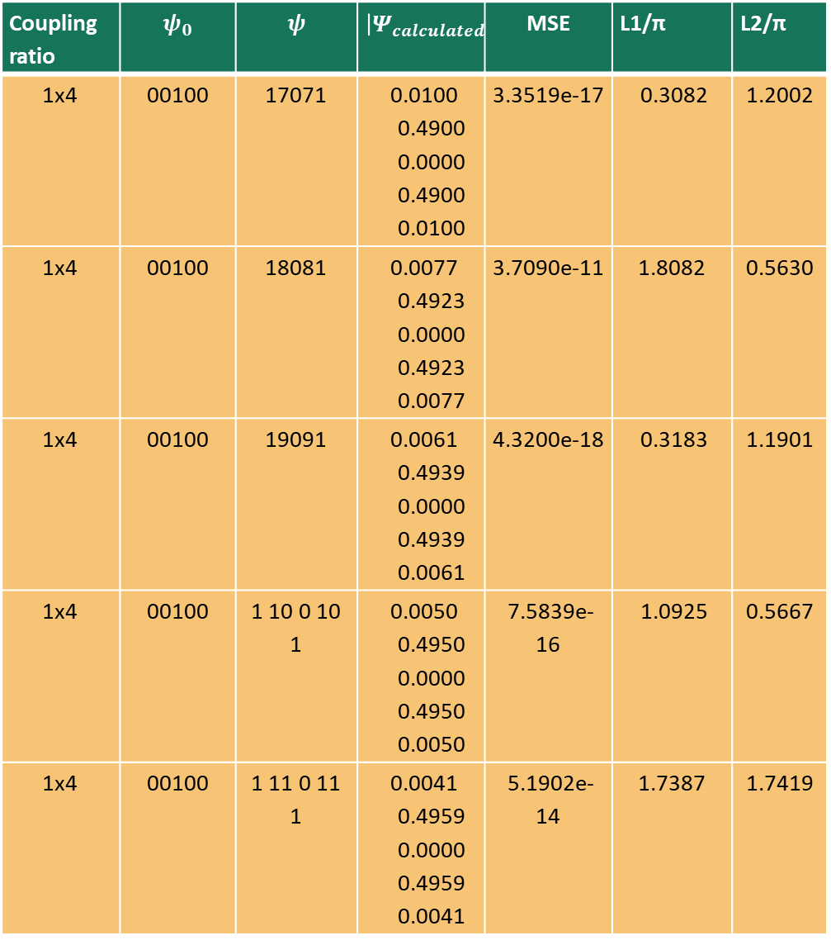
Coupling ratio | $$ψ_{0}$$ | $$ψ$$ | $${\left|Ψ_{calculated}\right|}^{2}$$ | MSE | L1/π | L2/π
1x4 | 00100 | 17071 | 0.0100 0.4900 0.0000 0.4900 0.0100 | 3.3519e-17 | 0.3082 | 1.2002
1x4 | 00100 | 18081 | 0.0077 0.4923 0.0000 0.4923 0.0077 | 3.7090e-11 | 1.8082 | 0.5630
1x4 | 00100 | 19091 | 0.0061 0.4939 0.0000 0.4939 0.0061 | 4.3200e-18 | 0.3183 | 1.1901
1x4 | 00100 | 1 10 0 10 1 | 0.0050 0.4950 0.0000 0.4950 0.0050 | 7.5839e-16 | 1.0925 | 0.5667
1x4 | 00100 | 1 11 0 11 1 | 0.0041 0.4959 0.0000 0.4959 0.0041 | 5.1902e-14 | 1.7387 | 1.7419

Slide 4
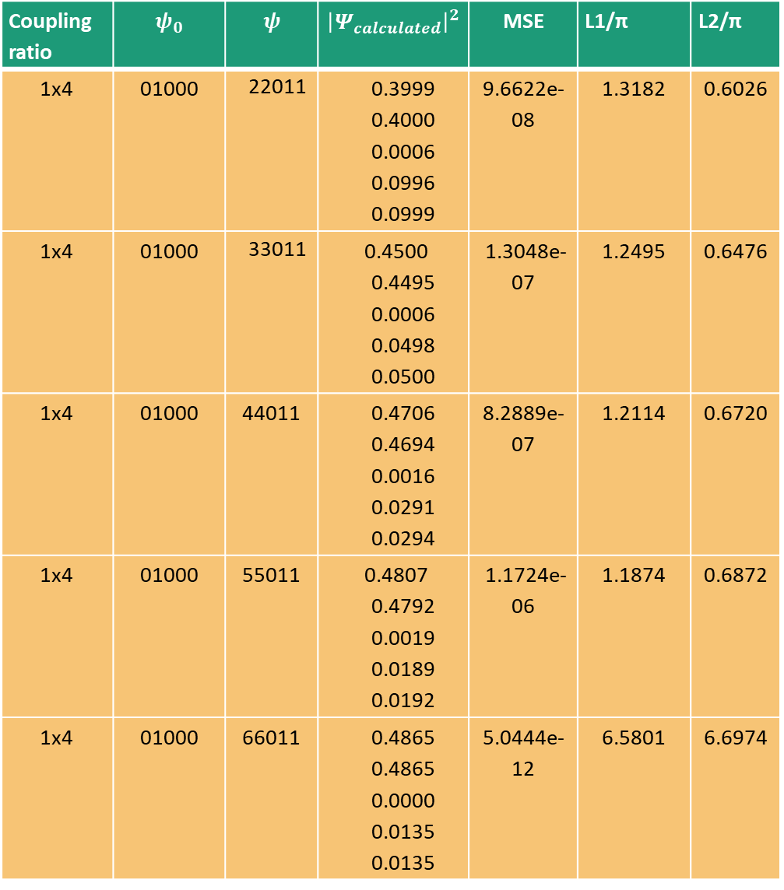
Coupling ratio | $$ψ_{0}$$ | $$ψ$$ | $${\left|Ψ_{calculated}\right|}^{2}$$ | MSE | L1/π | L2/π
1x4 | 01000 | 22011 | 0.3999 0.4000 0.0006 0.0996 0.0999 | 9.6622e-08 | 1.3182 | 0.6026
1x4 | 01000 | 33011 | 0.4500 0.4495 0.0006 0.0498 0.0500 | 1.3048e-07 | 1.2495 | 0.6476
1x4 | 01000 | 44011 | 0.4706 0.4694 0.0016 0.0291 0.0294 | 8.2889e-07 | 1.2114 | 0.6720
1x4 | 01000 | 55011 | 0.4807 0.4792 0.0019 0.0189 0.0192 | 1.1724e-06 | 1.1874 | 0.6872
1x4 | 01000 | 66011 | 0.4865 0.4865 0.0000 0.0135 0.0135 | 5.0444e-12 | 6.5801 | 6.6974
Korak 0.01

Slide 5
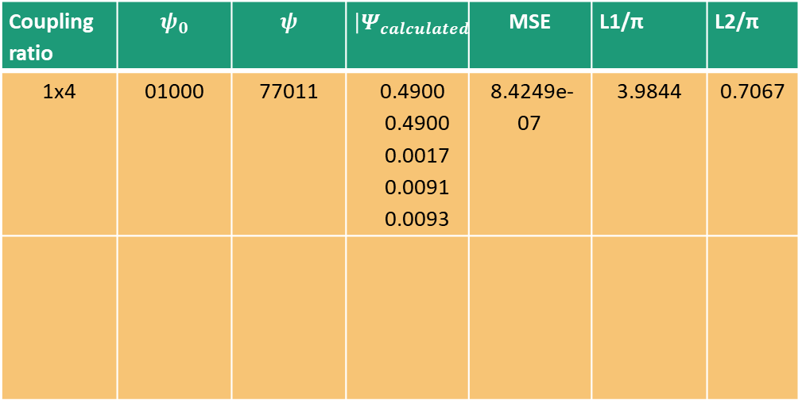
Coupling ratio | $$ψ_{0}$$ | $$ψ$$ | $${\left|Ψ_{calculated}\right|}^{2}$$ | MSE | L1/π | L2/π
1x4 | 01000 | 77011 | 0.4900 0.4900 0.0017 0.0091 0.0093 | 8.4249e-07 | 3.9844 | 0.7067

Slide 6
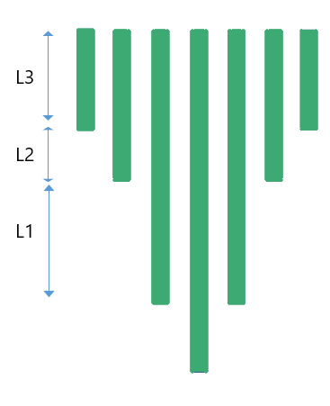
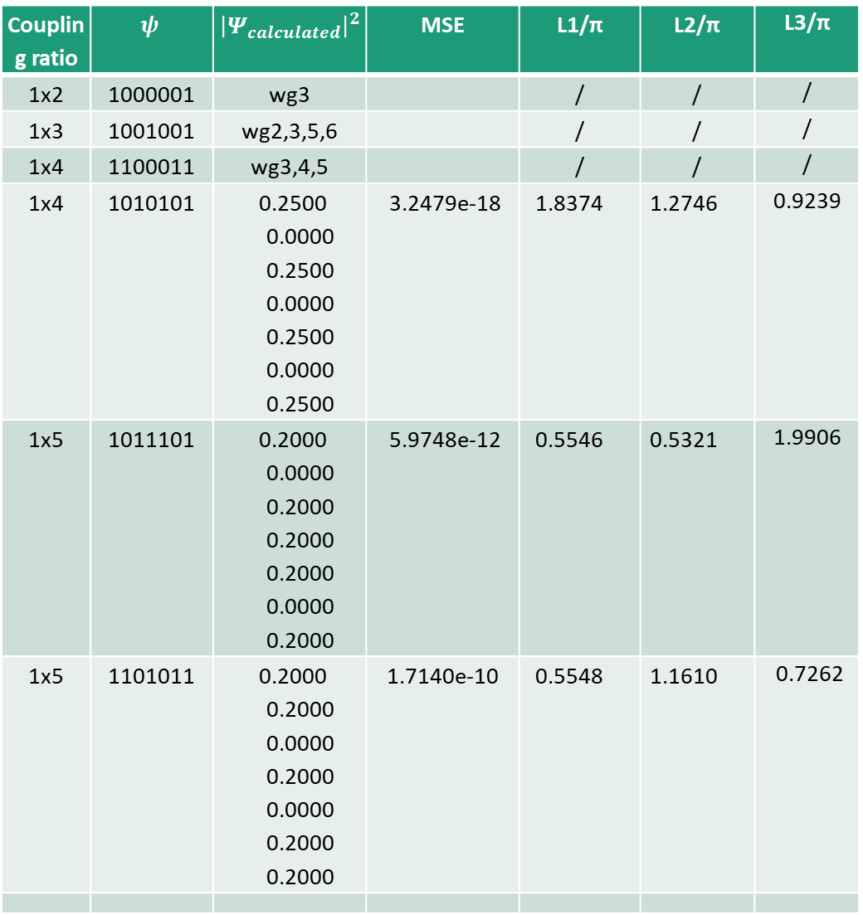
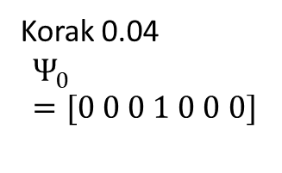
Coupling ratio | $$ψ$$ | $${\left|Ψ_{calculated}\right|}^{2}$$ | MSE | L1/π | L2/π | L3/π
1x2 | 1000001 | wg3 |  | / | / | /
1x3 | 1001001 | wg2,3,5,6 |  | / | / | /
1x4 | 1100011 | wg3,4,5 |  | / | / | /
1x4 | 1010101 | 0.2500 0.0000 0.2500 0.0000 0.2500 0.0000 0.2500 | 3.2479e-18 | 1.8374 | 1.2746 | 0.9239
1x5 | 1011101 | 0.2000 0.0000 0.2000 0.2000 0.2000 0.0000 0.2000 | 5.9748e-12 | 0.5546 | 0.5321 | 1.9906
1x5 | 1101011 | 0.2000 0.2000 0.0000 0.2000 0.0000 0.2000 0.2000 | 1.7140e-10 | 0.5548 | 1.1610 | 0.7262
Korak 0.04
$$Ψ_{0}=[0 0 0 1 0 0 0]$$
1x6 | 1110111 | 0.1667 0.1667 0.1667 0.0000 0.1667 0.1667 0.1667 | 1.3436e-12 | 0.8186 | 1.8160 | 1.2788
1x7 | 1111111 | 0.1429 0.1429 0.1429 0.1429 0.1429 0.1429 0.1429 | 1.1452e-11 | 0.3132 | 0.7997 | 0.7676

Slide 7
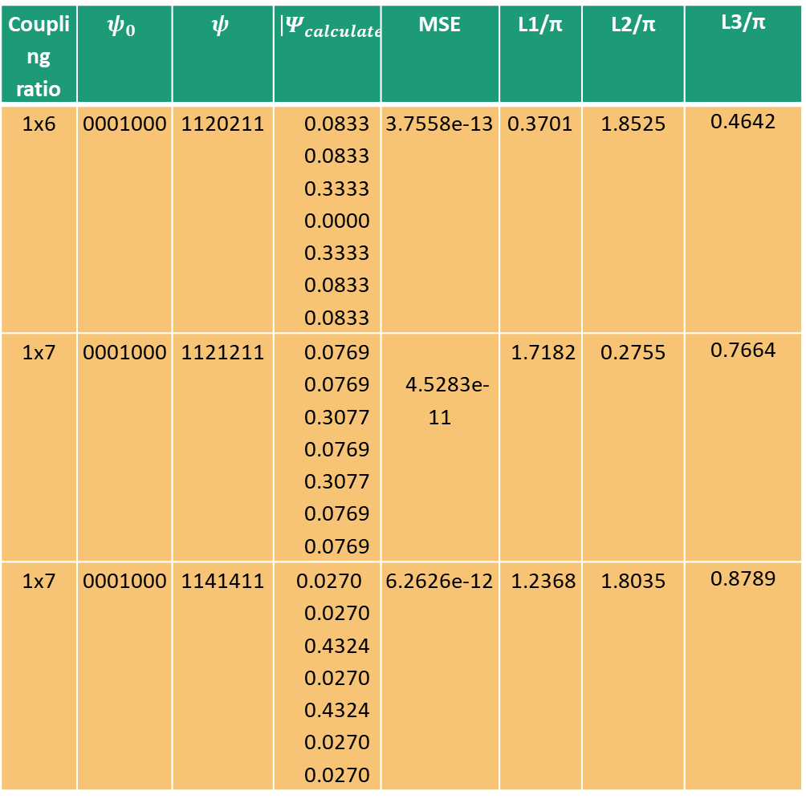
Coupling ratio | $$ψ_{0}$$ | $$ψ$$ | $${\left|Ψ_{calculated}\right|}^{2}$$ | MSE | L1/π | L2/π | L3/π
1x6 | 0001000 | 1120211 | 0.0833 0.0833 0.3333 0.0000 0.3333 0.0833 0.0833 | 3.7558e-13 | 0.3701 | 1.8525 | 0.4642
1x7 | 0001000 | 1121211 | 0.0769 0.0769 0.3077 0.0769 0.3077 0.0769 0.0769 | 4.5283e-11 | 1.7182 | 0.2755 | 0.7664
1x7 | 0001000 | 1141411 | 0.0270 0.0270 0.4324 0.0270 0.4324 0.0270 0.0270 | 6.2626e-12 | 1.2368 | 1.8035 | 0.8789
1x7 | 0001000 | 1151511 | 0.0182 0.0182 0.4546 0.0182 0.4546 0.0182 0.0182 | 4.2843e-11 | 1.1191 | 1.8832 | 1.3973
1x7 | 0001000 | 2340432 | 0.0690 0.1552 0.2759 0.0000 0.2759 0.1552 0.0690 | 3.6374e-16 | 1.8561 | 0.3057 | 1.2058
1x | 0001000 | 1234321 | 0.0227 0.0909 0.2046 0.3636 0.2046 0.0909 0.0227 | 2.2434e-11 | 0.2038 | 1.3132 | 1.7243
1x7 | 0001000 | 1112111 | 0.1000 0.1000 0.1000 0.4000 0.1000 0.1000 0.1000 | 1.3152e-10 | 0.1984 | 1.6394 | 1.1225

Slide 8
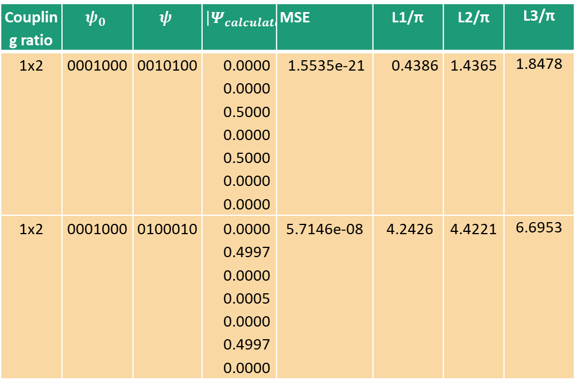
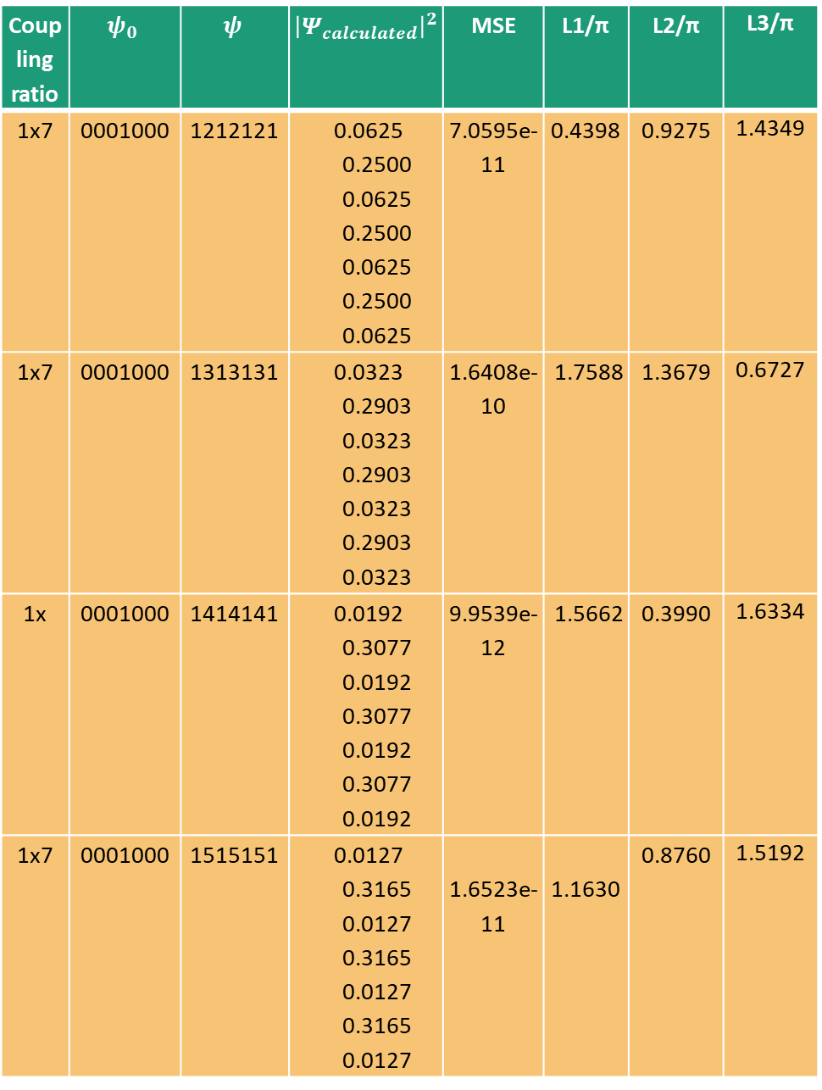
Coupling ratio | $$ψ_{0}$$ | $$ψ$$ | $${\left|Ψ_{calculated}\right|}^{2}$$ | MSE | L1/π | L2/π | L3/π
1x7 | 0001000 | 1212121 | 0.0625 0.2500 0.0625 0.2500 0.0625 0.2500 0.0625 | 7.0595e-11 | 0.4398 | 0.9275 | 1.4349
1x7 | 0001000 | 1313131 | 0.0323 0.2903 0.0323 0.2903 0.0323 0.2903 0.0323 | 1.6408e-10 | 1.7588 | 1.3679 | 0.6727
1x | 0001000 | 1414141 | 0.0192 0.3077 0.0192 0.3077 0.0192 0.3077 0.0192 | 9.9539e-12 | 1.5662 | 0.3990 | 1.6334
1x7 | 0001000 | 1515151 | 0.0127 0.3165 0.0127 0.3165 0.0127 0.3165 0.0127 | 1.6523e-11 | 1.1630 | 0.8760 | 1.5192
Coupling ratio | $$ψ_{0}$$ | $$ψ$$ | $${\left|Ψ_{calculated}\right|}^{2}$$ | MSE | L1/π | L2/π | L3/π
1x2 | 0001000 | 0010100 | 0.0000 0.0000 0.5000 0.0000 0.5000 0.0000 0.0000 | 1.5535e-21 | 0.4386 | 1.4365 | 1.8478
1x2 | 0001000 | 0100010 | 0.0000 0.4997 0.0000 0.0005 0.0000 0.4997 0.0000 | 5.7146e-08 | 4.2426 | 4.4221 | 6.6953

Slide 9
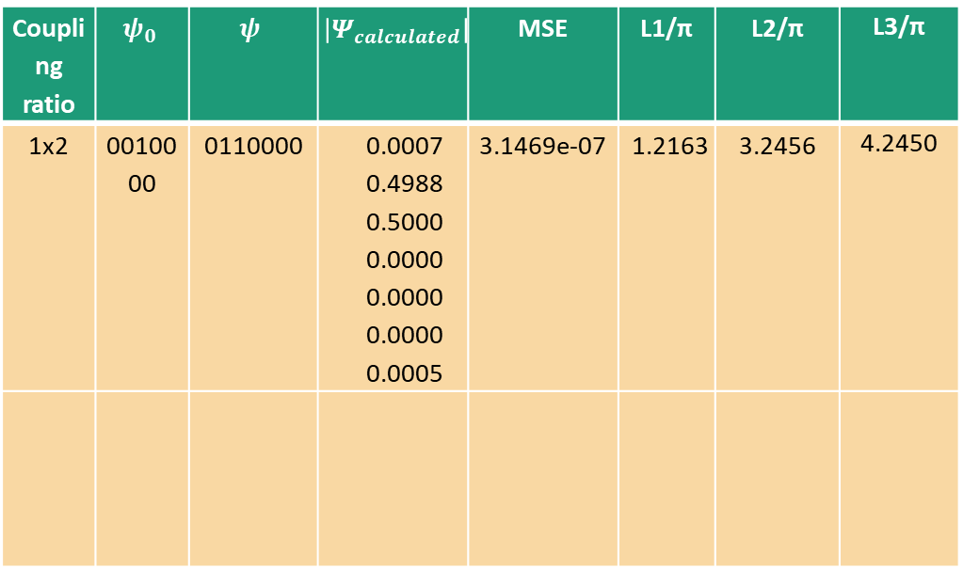
Coupling ratio | $$ψ_{0}$$ | $$ψ$$ | $${\left|Ψ_{calculated}\right|}^{2}$$ | MSE | L1/π | L2/π | L3/π
1x2 | 0010000 | 0110000 | 0.0007 0.4988 0.5000 0.0000 0.0000 0.0000 0.0005 | 3.1469e-07 | 1.2163 | 3.2456 | 4.2450

Slide 10
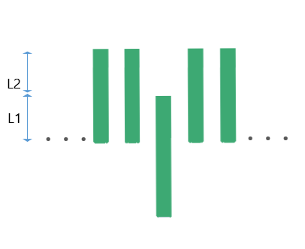
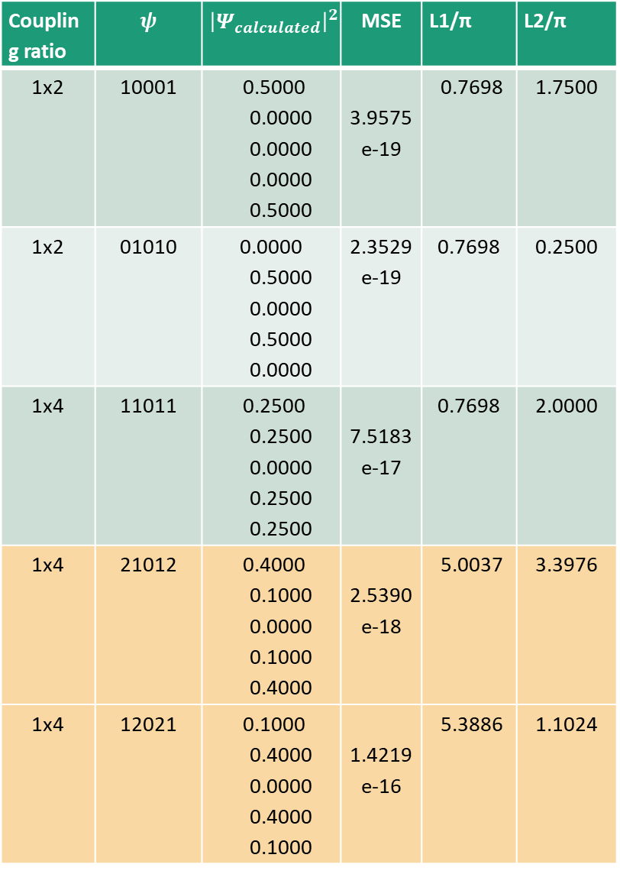
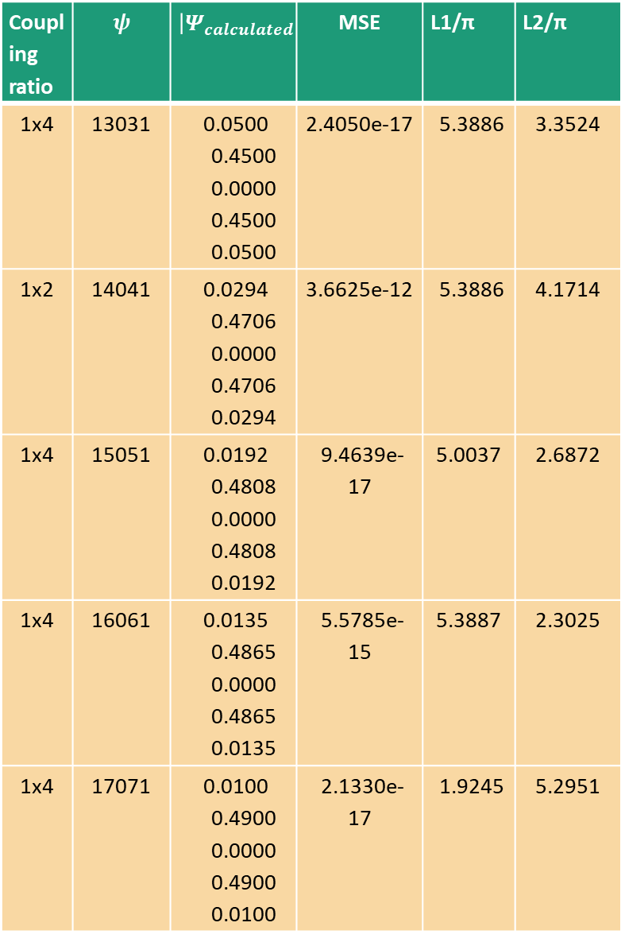
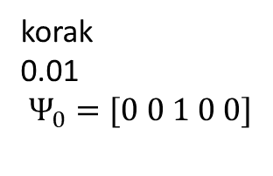
n=5
Coupling ratio | $$ψ$$ | $${\left|Ψ_{calculated}\right|}^{2}$$ | MSE | L1/π | L2/π
1x2 | 10001 | 0.5000 0.0000 0.0000 0.0000 0.5000 | 3.9575e-19 | 0.7698 | 1.7500
1x2 | 01010 | 0.0000 0.5000 0.0000 0.5000 0.0000 | 2.3529e-19 | 0.7698 | 0.2500
1x4 | 11011 | 0.2500 0.2500 0.0000 0.2500 0.2500 | 7.5183e-17 | 0.7698 | 2.0000
1x4 | 21012 | 0.4000 0.1000 0.0000 0.1000 0.4000 | 2.5390e-18 | 5.0037 | 3.3976
1x4 | 12021 | 0.1000 0.4000 0.0000 0.4000 0.1000 | 1.4219e-16 | 5.3886 | 1.1024
Coupling ratio | $$ψ$$ | $${\left|Ψ_{calculated}\right|}^{2}$$ | MSE | L1/π | L2/π
1x4 | 13031 | 0.0500 0.4500 0.0000 0.4500 0.0500 | 2.4050e-17 | 5.3886 | 3.3524
1x2 | 14041 | 0.0294 0.4706 0.0000 0.4706 0.0294 | 3.6625e-12 | 5.3886 | 4.1714
1x4 | 15051 | 0.0192 0.4808 0.0000 0.4808 0.0192 | 9.4639e-17 | 5.0037 | 2.6872
1x4 | 16061 | 0.0135 0.4865 0.0000 0.4865 0.0135 | 5.5785e-15 | 5.3887 | 2.3025
1x4 | 17071 | 0.0100 0.4900 0.0000 0.4900 0.0100 | 2.1330e-17 | 1.9245 | 5.2951
korak 0.01
$$Ψ_{0}=[0 0 1 0 0]$$

Slide 11
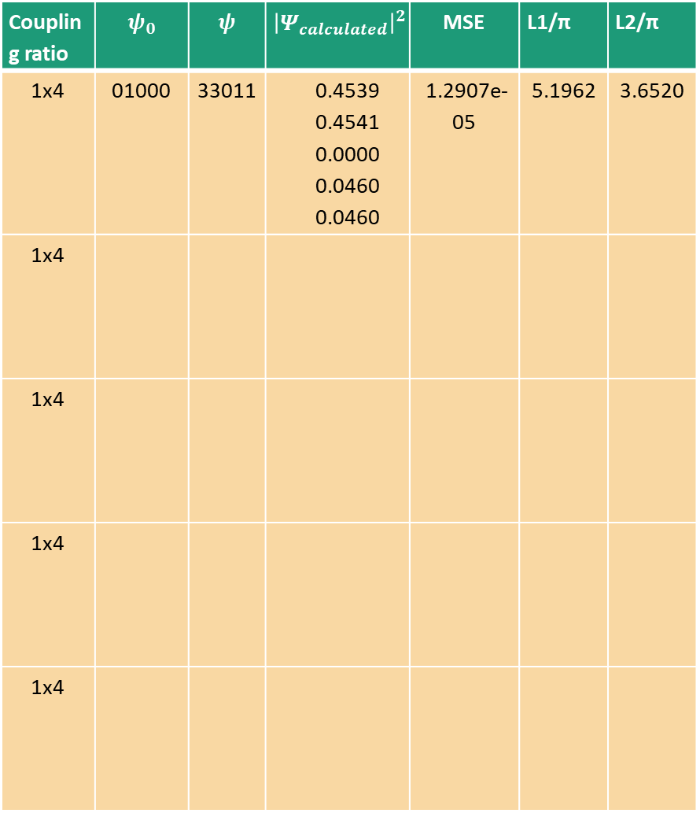
Coupling ratio | $$ψ_{0}$$ | $$ψ$$ | $${\left|Ψ_{calculated}\right|}^{2}$$ | MSE | L1/π | L2/π
1x4 | 01000 | 33011 | 0.4539 0.4541 0.0000 0.0460 0.0460 | 1.2907e-05 | 5.1962 | 3.6520
1x4
1x4
1x4
1x4

Slide 12
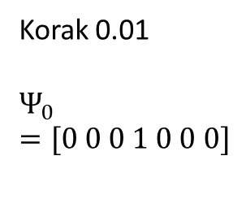
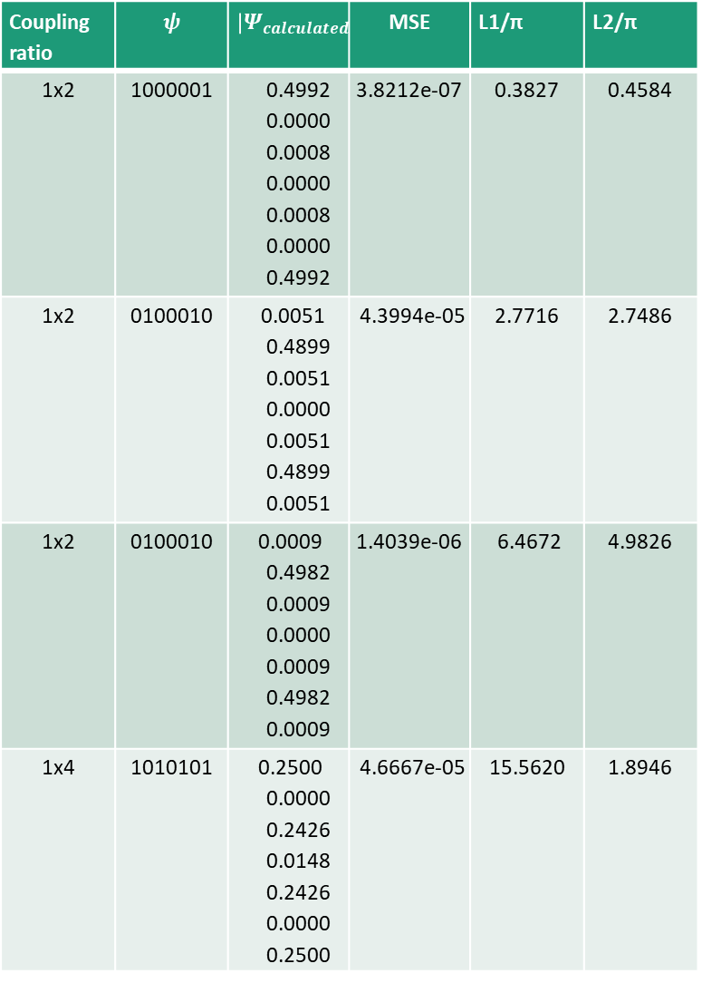
n=7
1x4 | 1100011 | 0.2500 0.2494 0.0006 0.0000 0.0006 0.2494 0.2500 | 2.2373e-07 | 4.9749 | 15.3649
1x4 | 0110110 | 0.0006 0.2494 0.2500 0.0000 0.2500 0.2494 0.0006 | 2.2374e-07 | 4.9748 | 0.5157
1x6 | 1110111 | 0.1667 0.1784 0.1549 0.0000 0.1549 0.1784 0.1667 | 7.9079e-05 | 12.6285 | 9.7613
Coupling ratio | $$ψ$$ | $${\left|Ψ_{calculated}\right|}^{2}$$ | MSE | L1/π | L2/π
1x2 | 1000001 | 0.4992 0.0000 0.0008 0.0000 0.0008 0.0000 0.4992 | 3.8212e-07 | 0.3827 | 0.4584
1x2 | 0100010 | 0.0051 0.4899 0.0051 0.0000 0.0051 0.4899 0.0051 | 4.3994e-05 | 2.7716 | 2.7486
1x2 | 0100010 | 0.0009 0.4982 0.0009 0.0000 0.0009 0.4982 0.0009 | 1.4039e-06 | 6.4672 | 4.9826
1x4 | 1010101 | 0.2500 0.0000 0.2426 0.0148 0.2426 0.0000 0.2500 | 4.6667e-05 | 15.5620 | 1.8946
Korak 0.01
$$Ψ_{0}=[0 0 0 1 0 0 0]$$

Slide 13
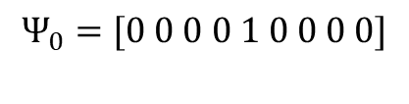
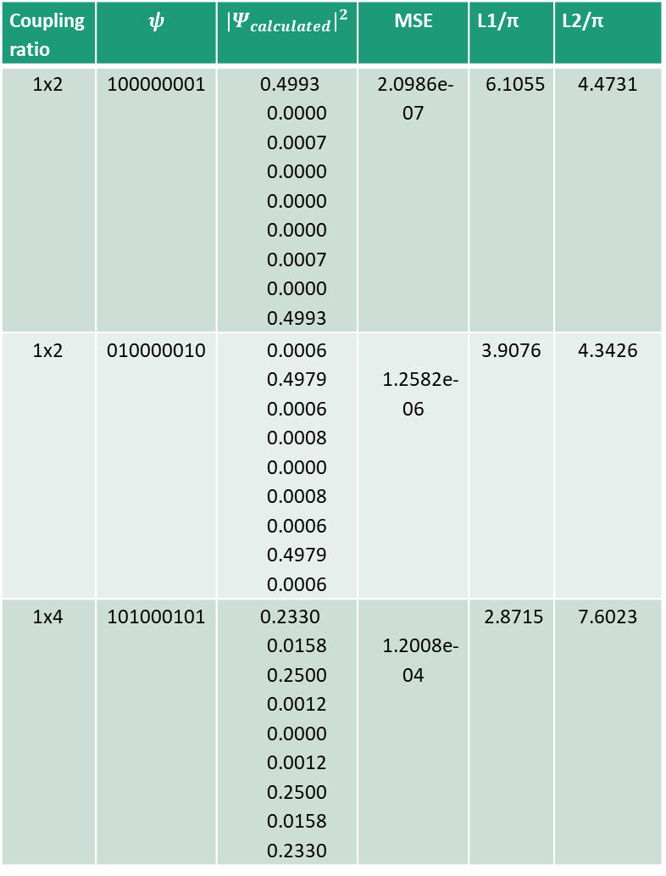
n=9
Coupling ratio | $$ψ$$ | $${\left|Ψ_{calculated}\right|}^{2}$$ | MSE | L1/π | L2/π
1x2 | 100000001 | 0.4993 0.0000 0.0007 0.0000 0.0000 0.0000 0.0007 0.0000 0.4993 | 2.0986e-07 | 6.1055 | 4.4731
1x2 | 010000010 | 0.0006 0.4979 0.0006 0.0008 0.0000 0.0008 0.0006 0.4979 0.0006 | 1.2582e-06 | 3.9076 | 4.3426
1x4 | 101000101 | 0.2330 0.0158 0.2500 0.0012 0.0000 0.0012 0.2500 0.0158 0.2330 | 1.2008e-04 | 2.8715 | 7.6023
1x4 | 110000011 | 0.2500 0.2499 0.0000 0.0001 0.0000 0.0001 0.0000 0.2499 0.2500 | 5.9636e-09 | 0.8754 | 6.5244
1x4 | 011000110 | 0.0001 0.2500 0.2475 0.0024 0.0000 0.0024 0.2475 0.2500 0.0001 | 2.7051e-06 | 3.9075 | 7.8923
1x6 | 111000111 | 0.1683 0.1617 0.1683 0.0016 0.0000 0.0016 0.1683 0.1617 0.1683 | 7.1941e-06 | 0.3827 | 7.2447
1x8 | 111101111 | 0.1231 0.1250 0.1241 0.1279 0.0000 0.1279 0.1241 0.1250 0.1231 | 2.8760e-06 | 4.7971 | 5.0006
$$Ψ_{0}=[0 0 0 0 1 0 0 0 0]$$

